Slide 1


Authoring, peer-review and publication in one place, for the first time!
Pensoft Journal System (PJS 2.0)
Lyubomir Penev
OASPA Conference, Riga, 18-20 Sep 2013
ViBRANT

Slide 2
The “Publishing Bottleneck (in Biodiversity)”?
What is that?

Slide 3
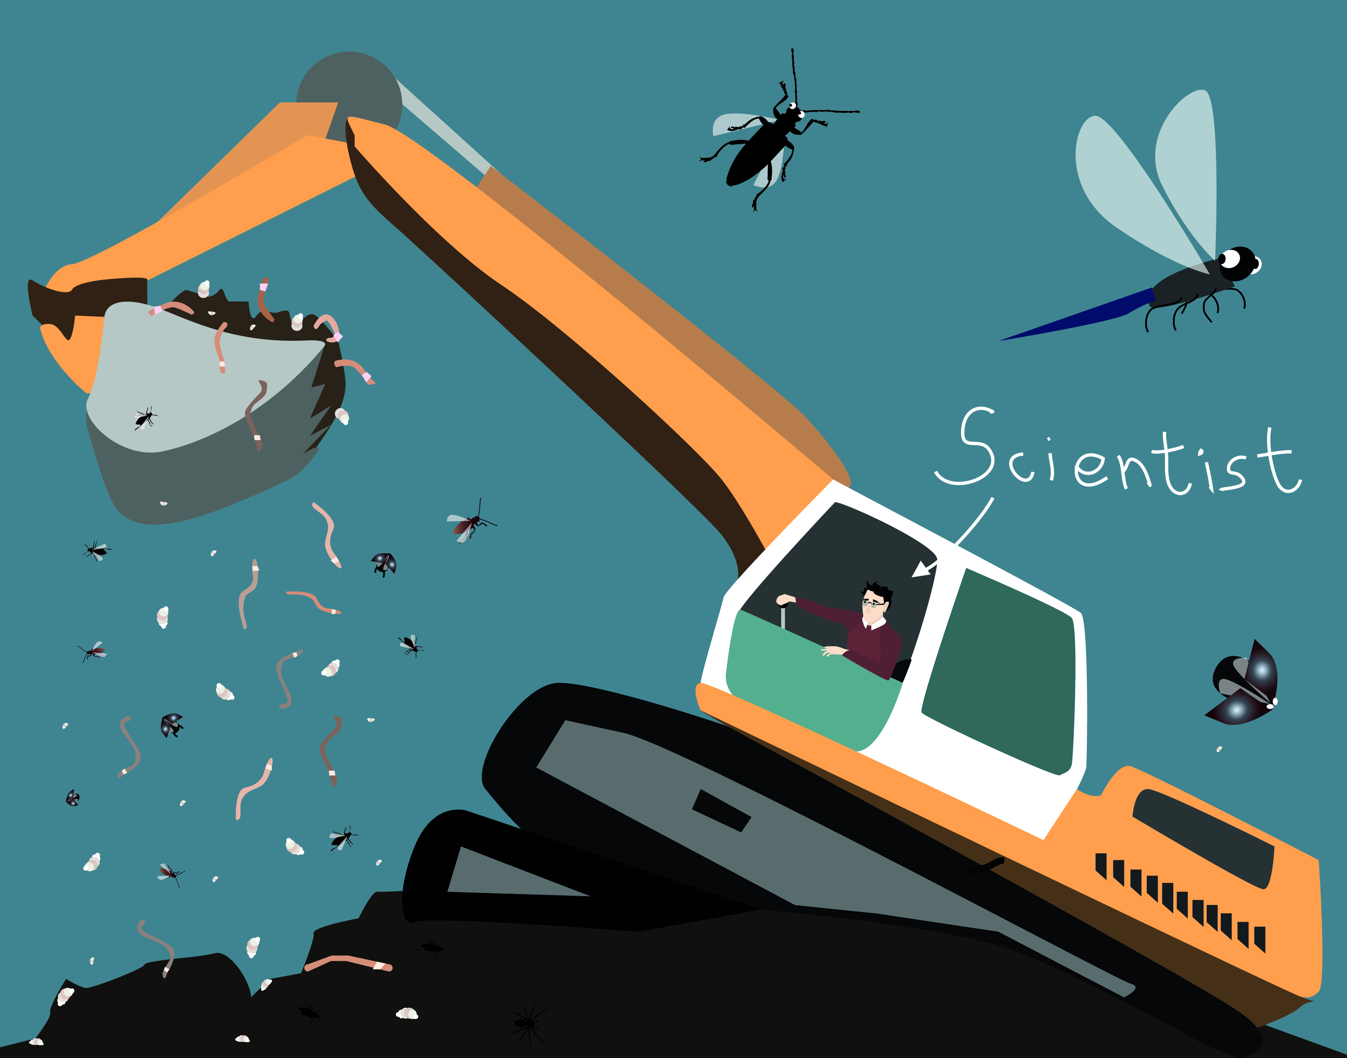
Massive sampling/data gathering

Slide 4
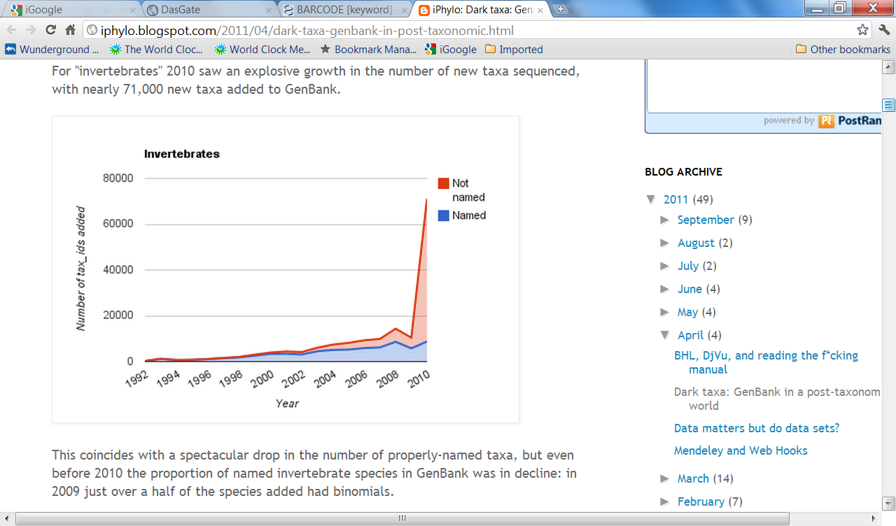
‘Dark species’ increase dramatically!
Rod Page, iPhylo blogspot, 12 April 2011

Slide 5

The paper/PDF impediment

Slide 6
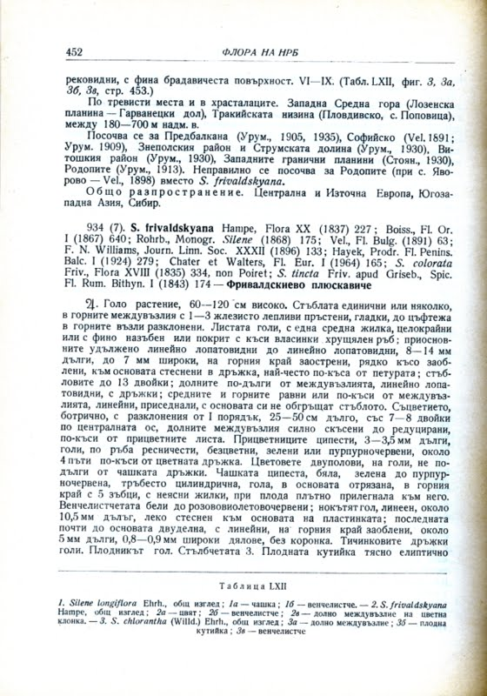
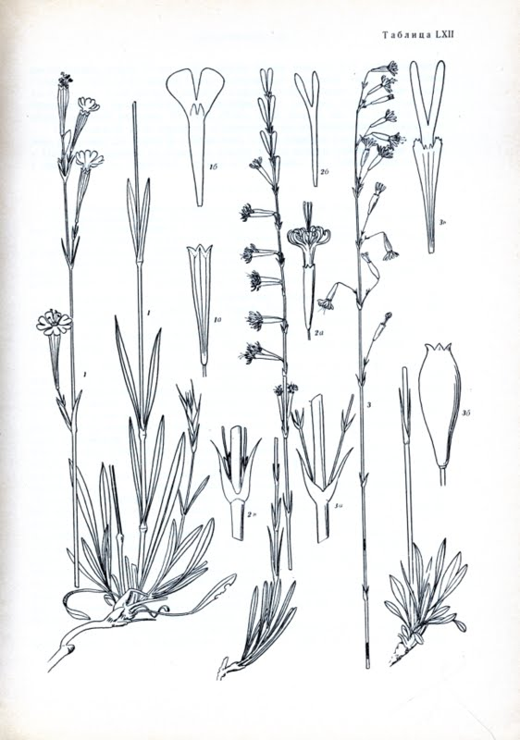
… the burden or OCR, double-keying and markup of paper/PDF literature

Slide 7

The “impact factor” pressure

Slide 8
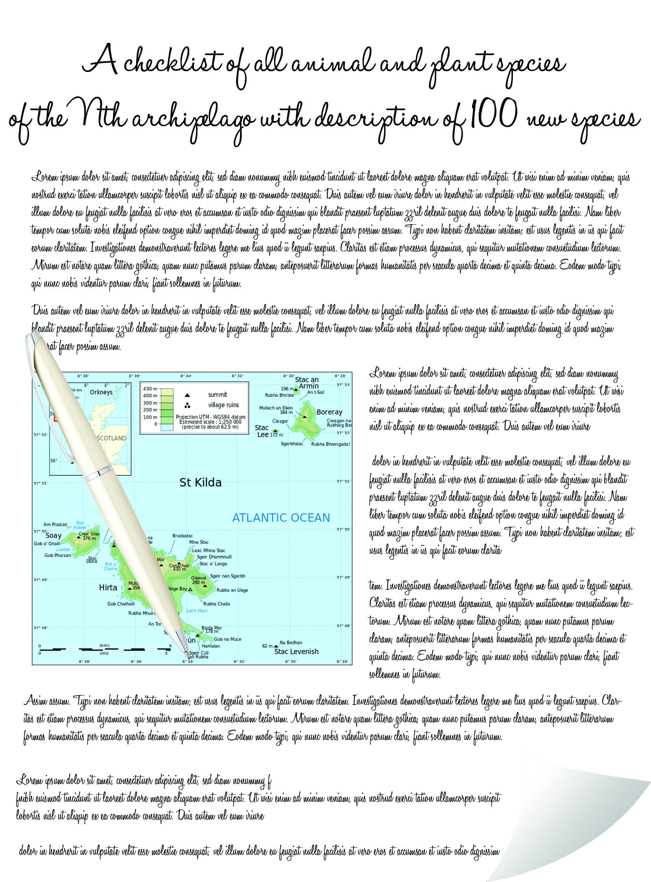

Slide 9
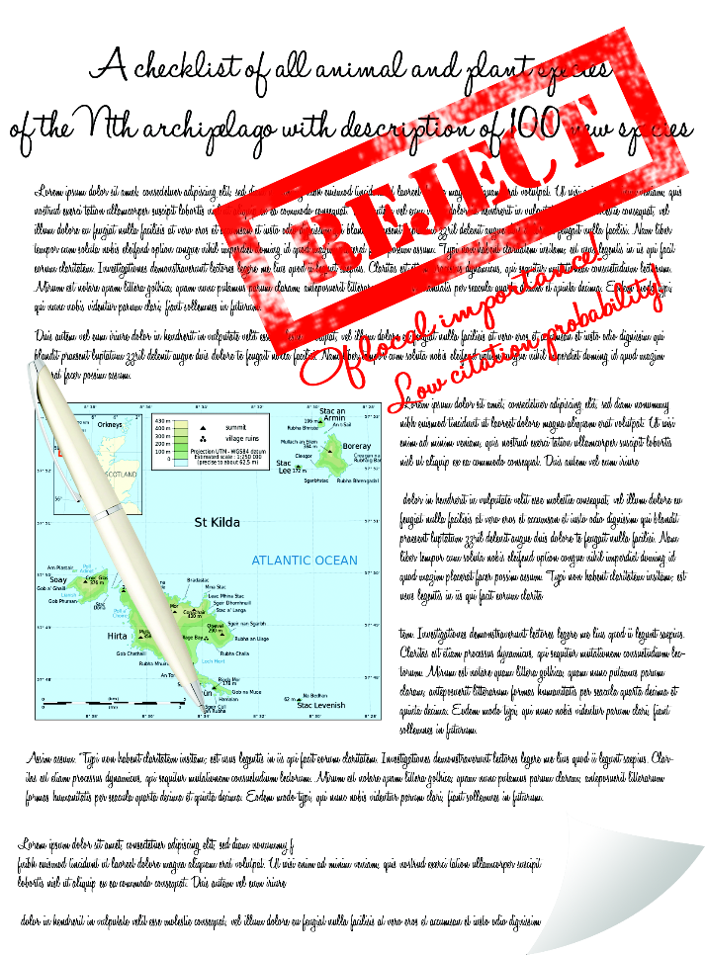

Slide 10
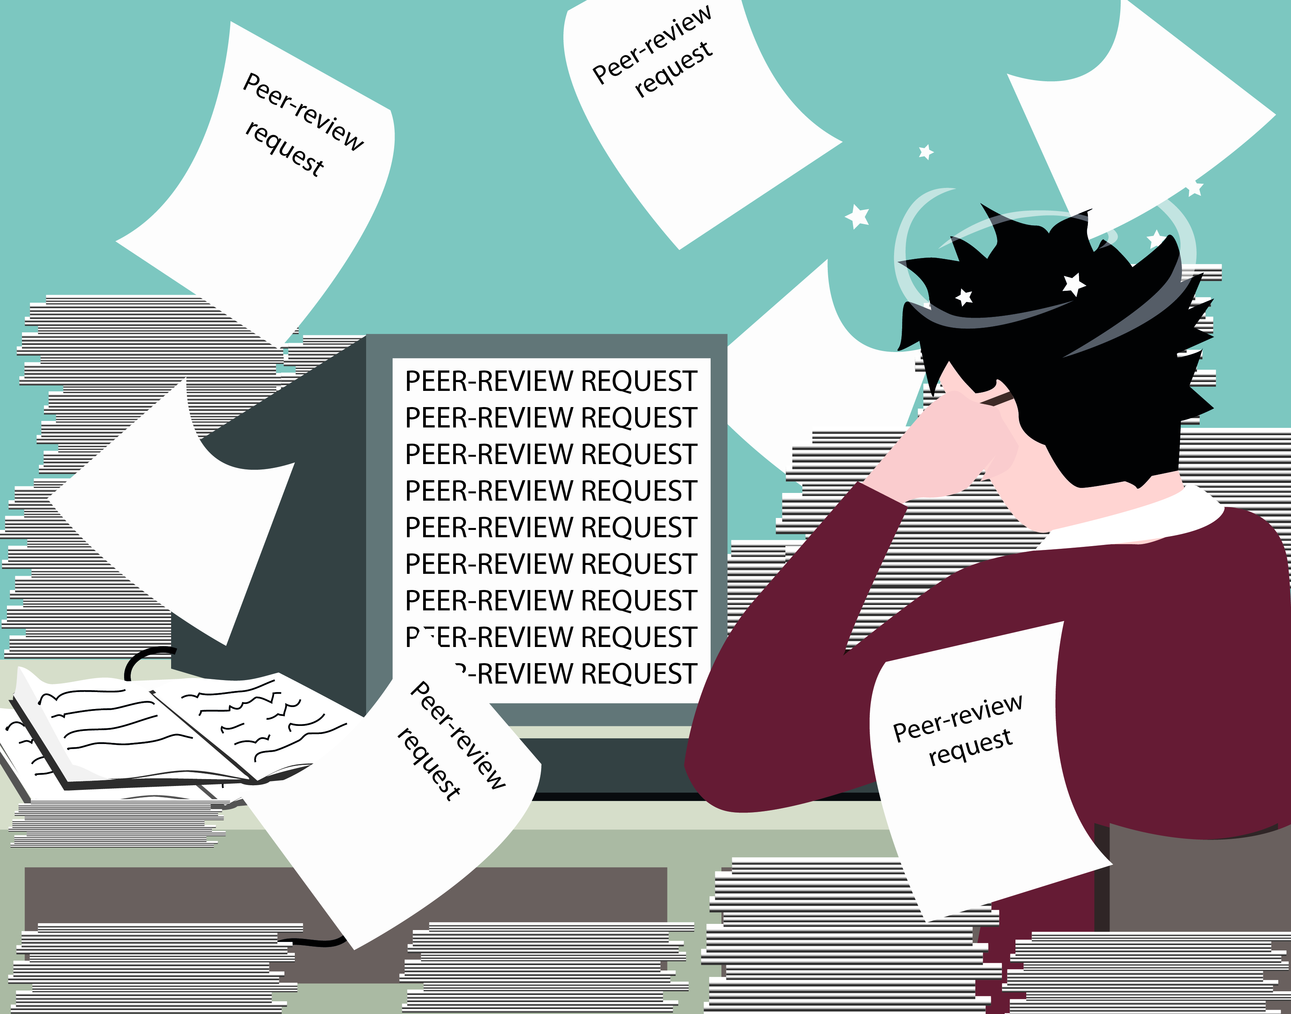
The “peer review” pressure

Slide 11
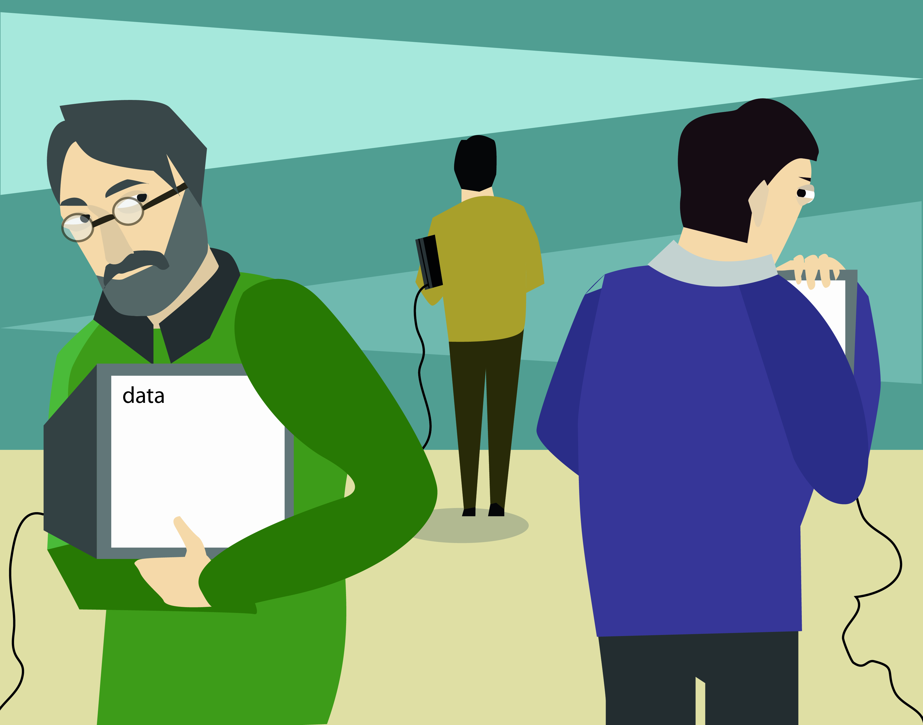
Low uptake of open data publishing/sharing

Slide 12
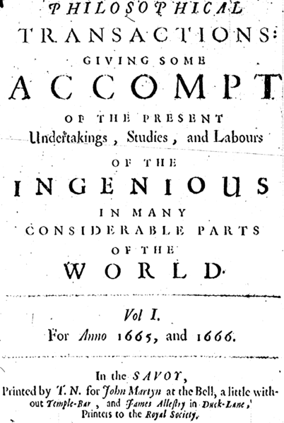
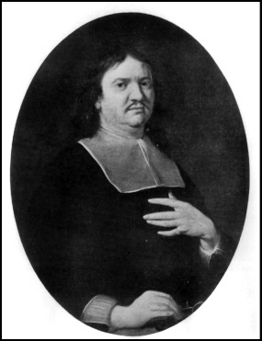
Source: Wikipedia

Slide 13
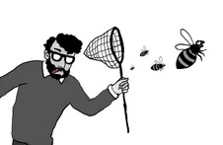
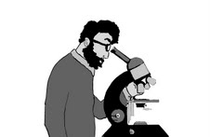

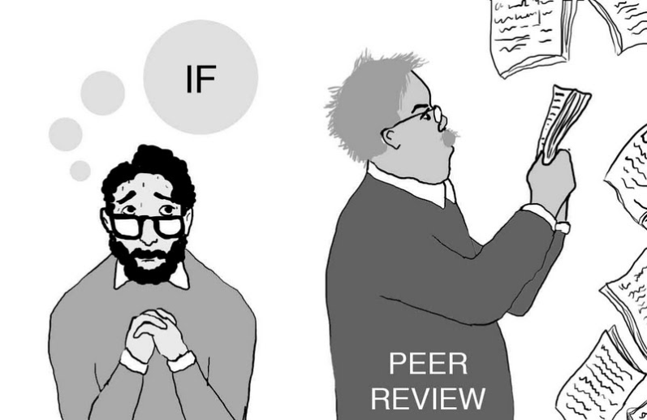
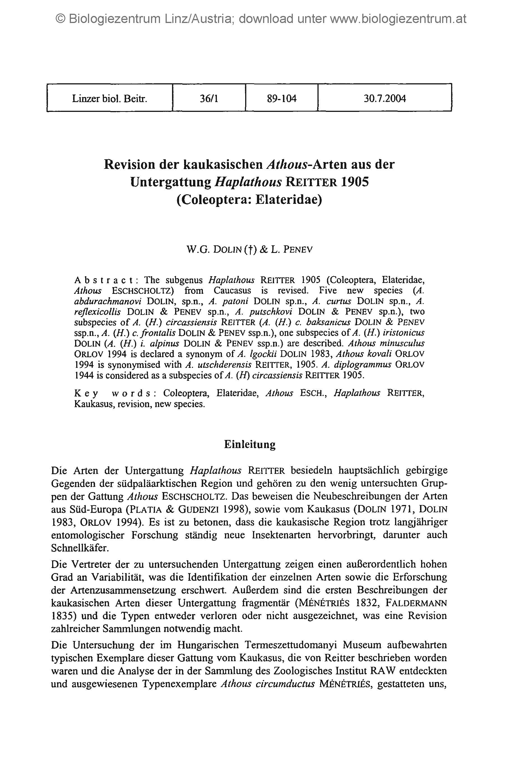




Primary data

Slide 14
A solution?

Slide 15
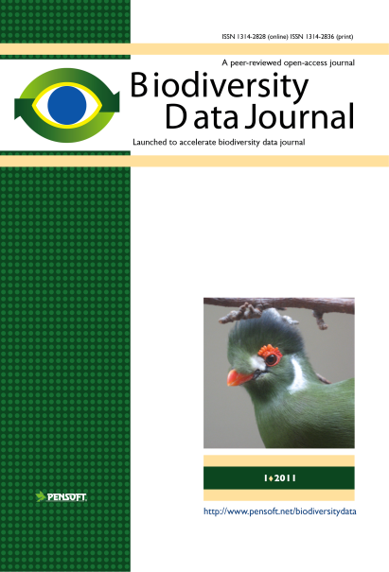
RE-USE
of
CONTENT
Publishing and sharing of primary data
Primary data

Slide 16
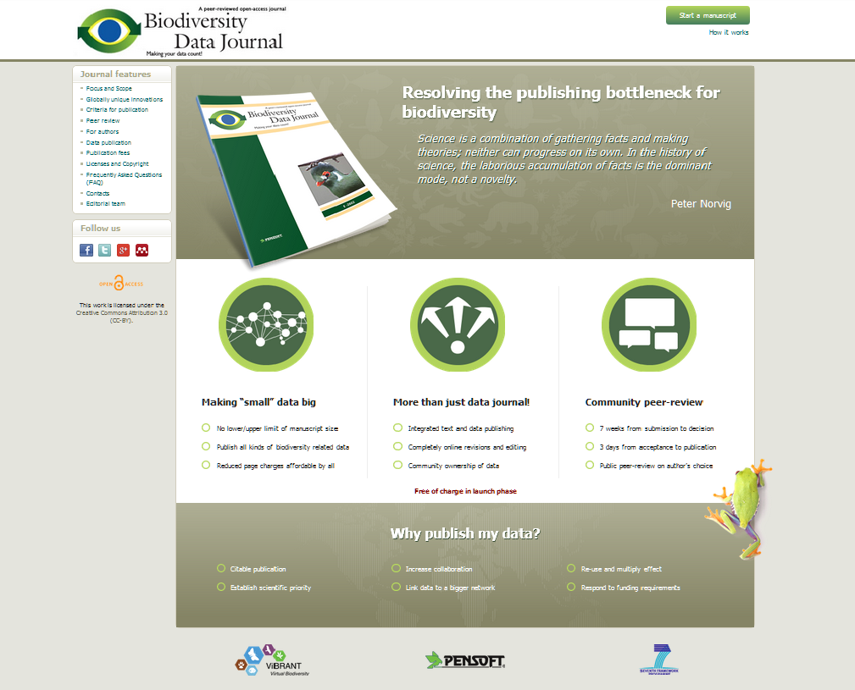

Slide 17
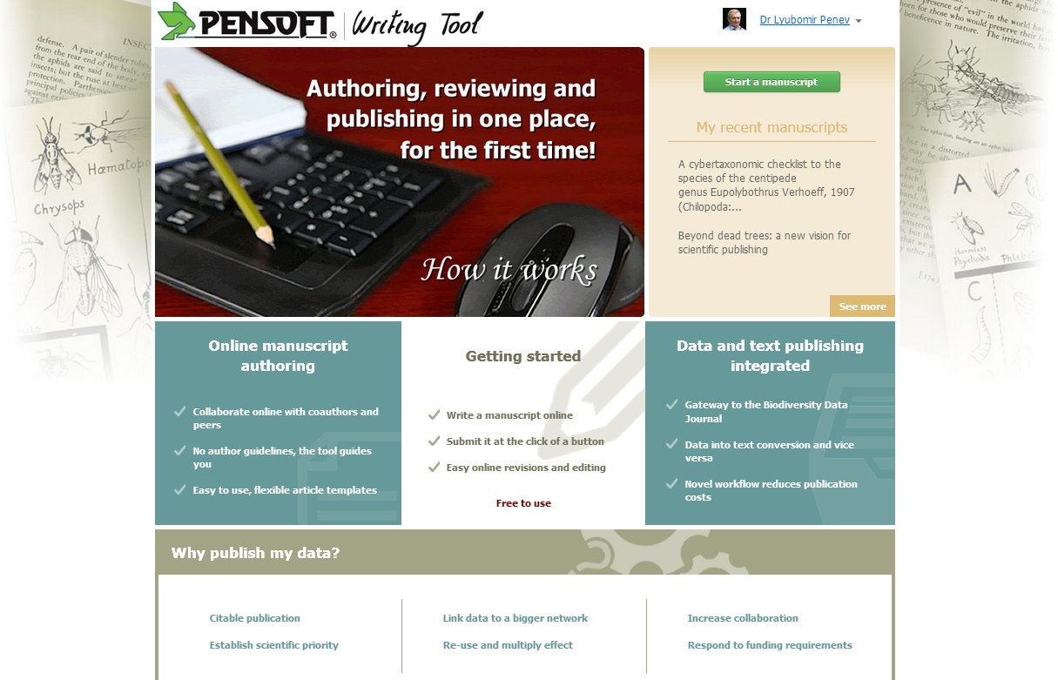

Slide 18

Launch date http://biodiversitydatajournal.com

Slide 19

Novel concepts
Authoring, reviewing and publishing in one place, for the first time!
Detailed upfront markup!
“Small” datasets imported in and downloadable from text
Large datasets published as data papers
Text stored and treated as data
Community peer-reviewed and community owned interoperable data
Narrative (text) and data integrated publishing

Slide 20









How we do that?
Collaborative
ARTICLE AUTHORING
(PENSOFT WRITING
TOOL)
Automatedsubmission
Community peer-review
(Pensoft JOURNAL
SYSTEM 2.0)
Revisions
online
Authors, Reviewers, Editors, Mentors, Copyeditors
MANUSCRIPT published
XML text + data
ARTICLES
Biblio-
graphies
Occurr-
ence data
Taxon treatments
Taxon names
Plazi
Wiki
COL

Slide 21
Novel work flows
Authoring
Peer-review and editorial manager
Publishing and dissemination

Slide 22
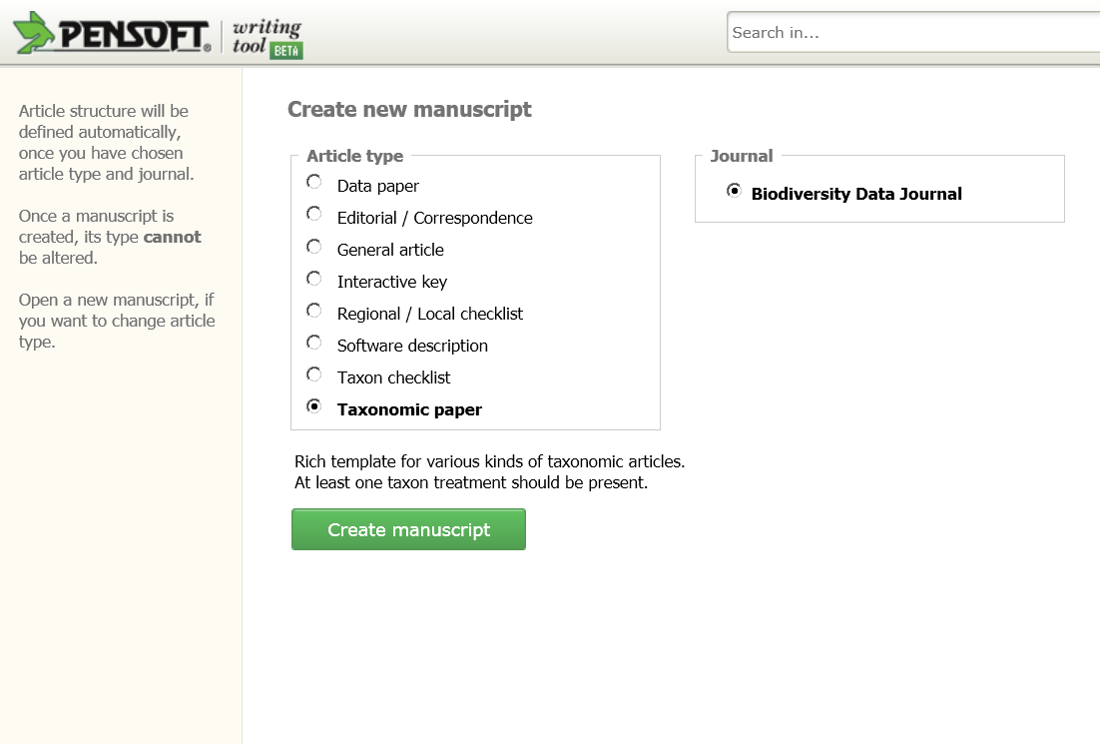
Article templates

Slide 23
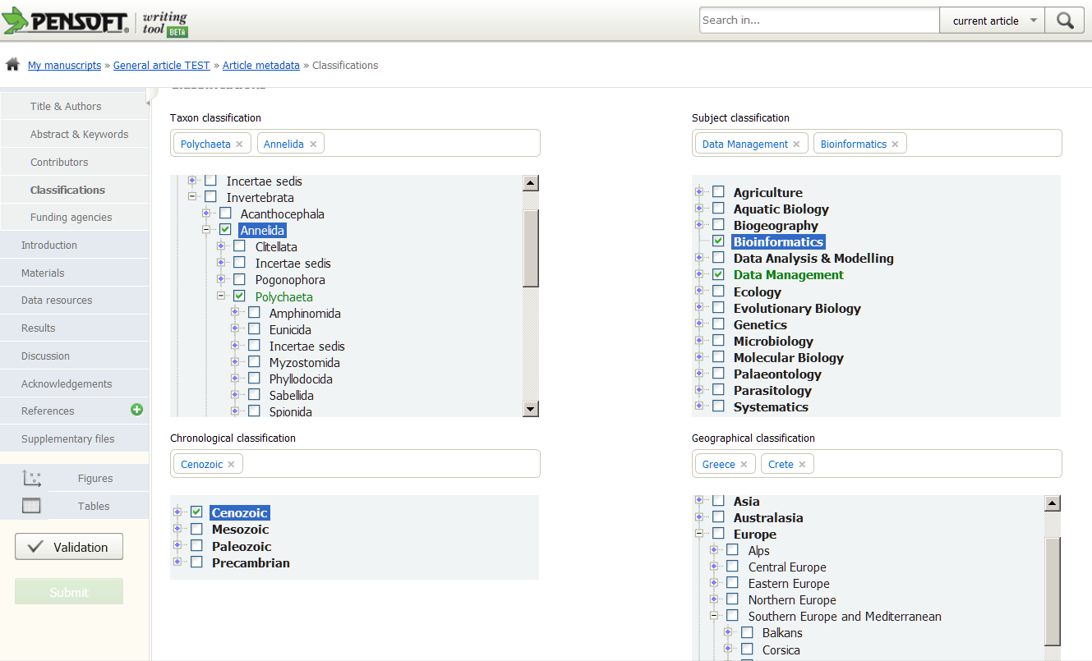
Classifications

Slide 24
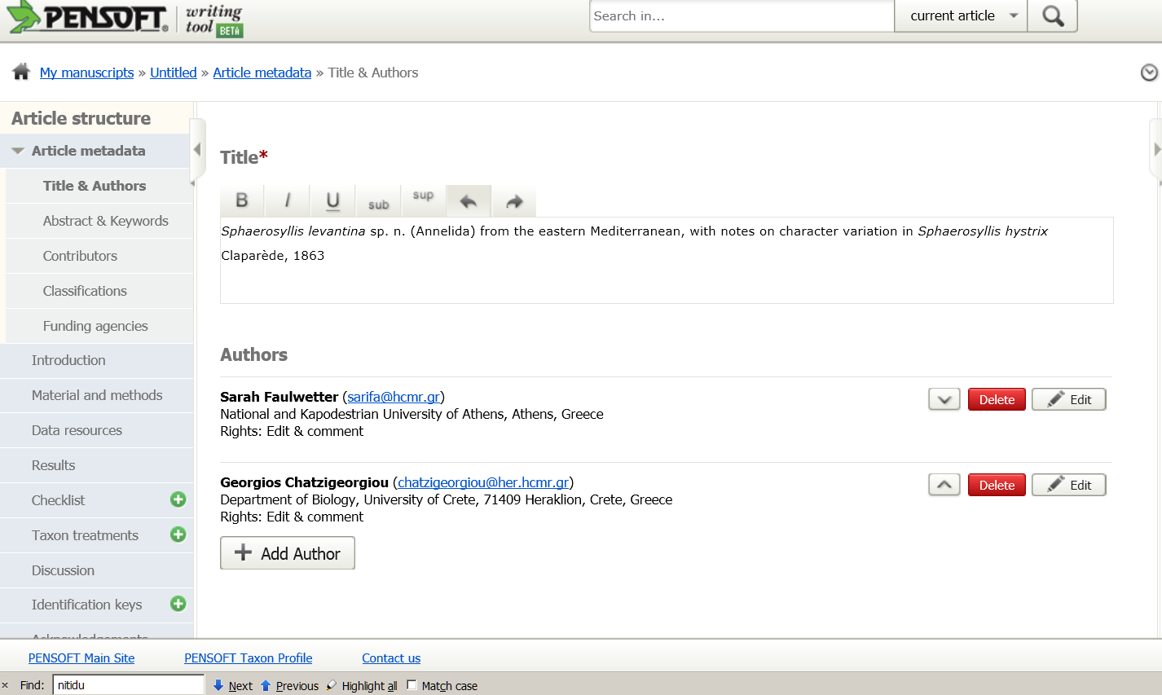
Invite co-authors

Slide 25
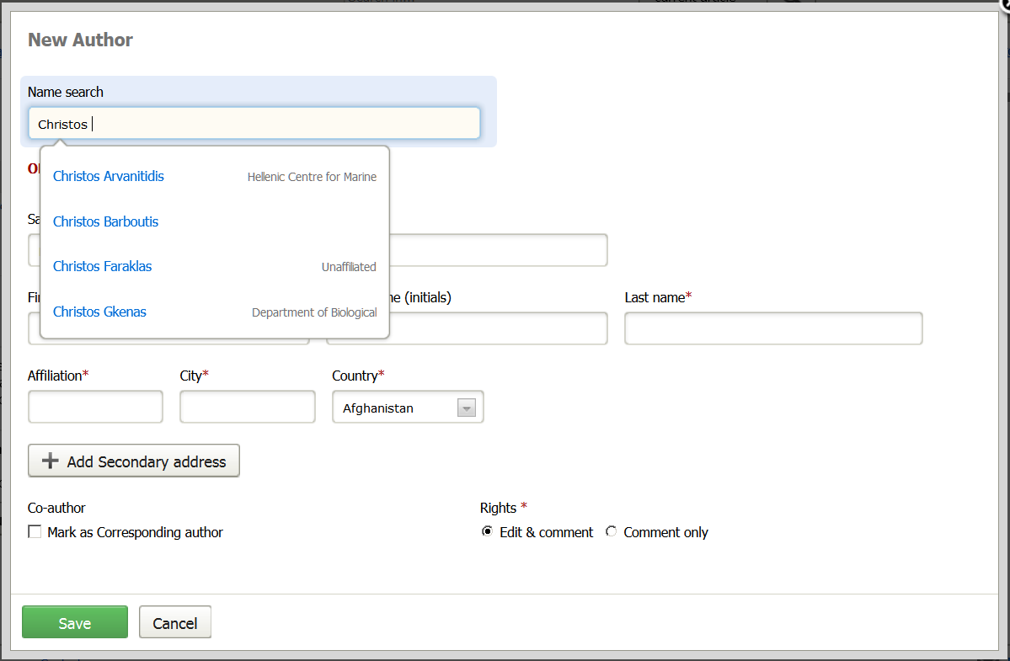
Inivte a co-author

Slide 26
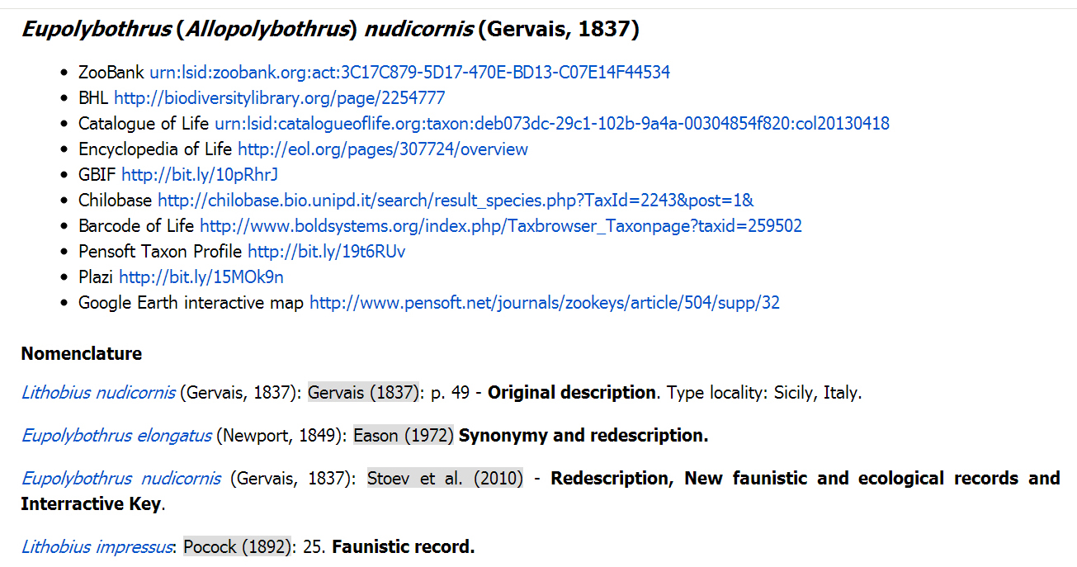
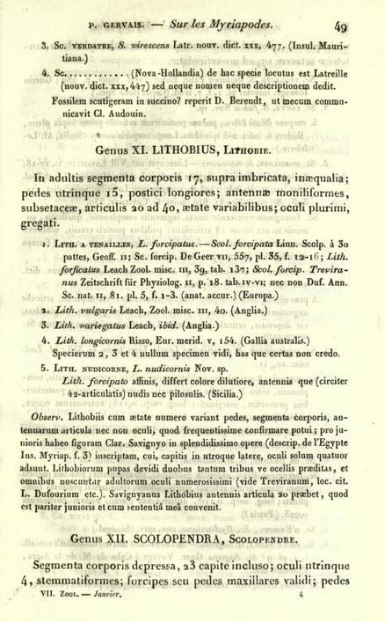
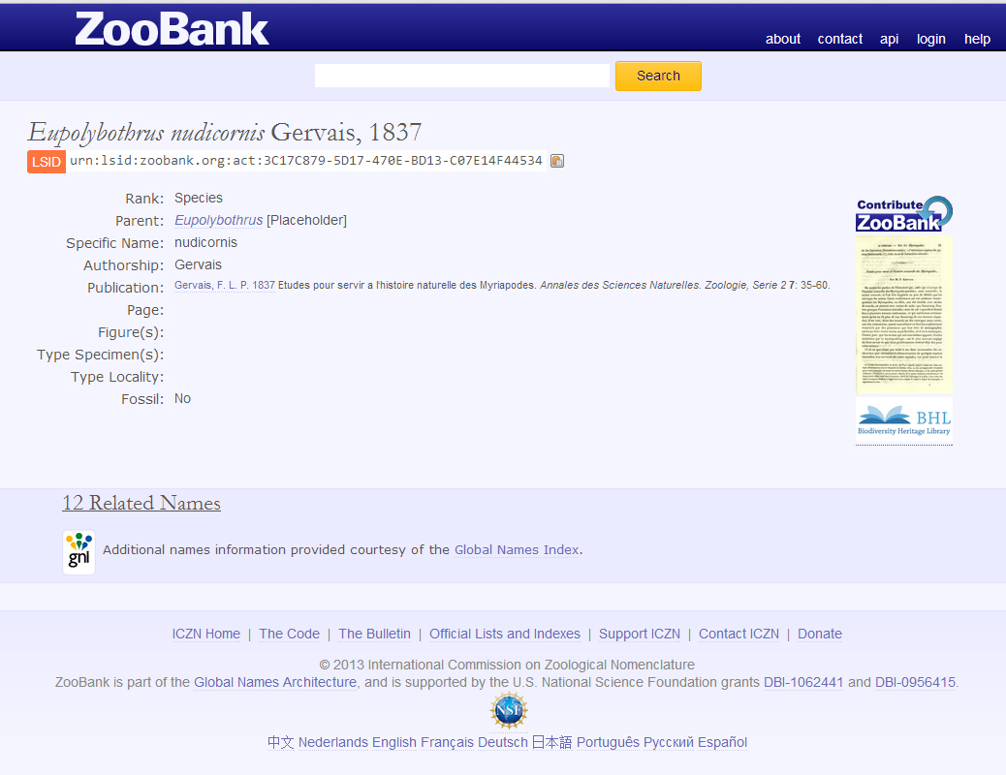
External links

Slide 27
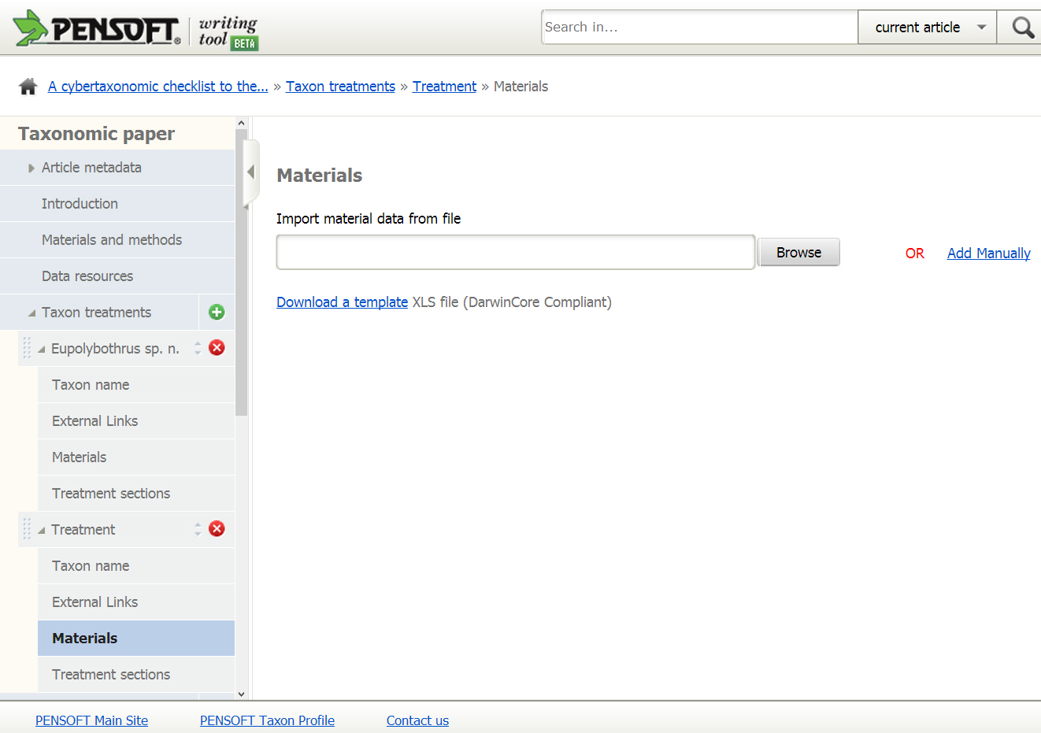
Import tabular data

Slide 28
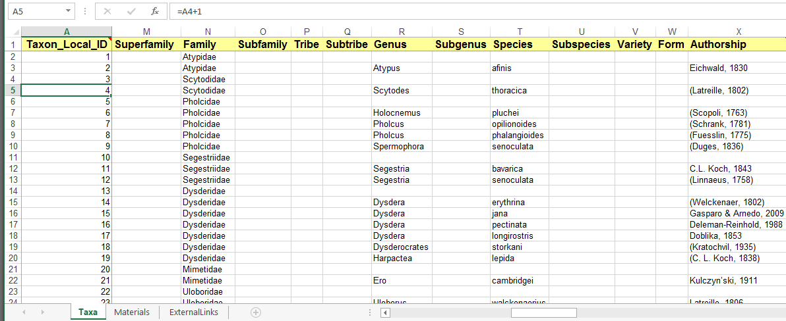
Template

Slide 29
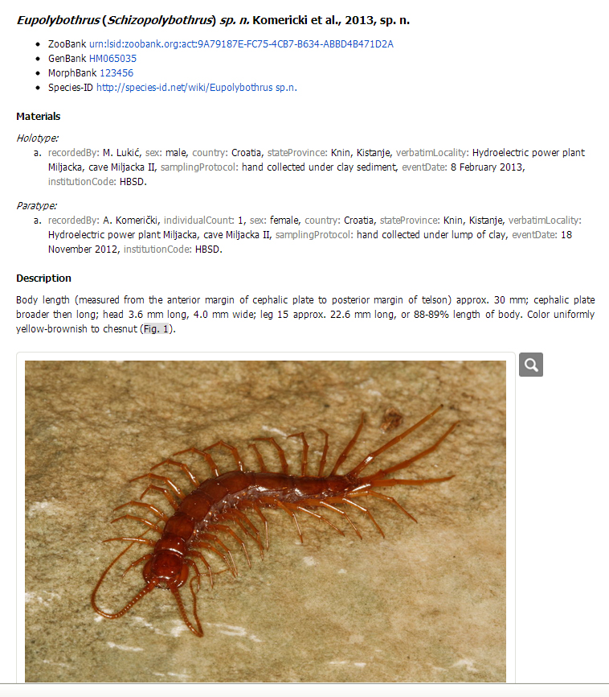
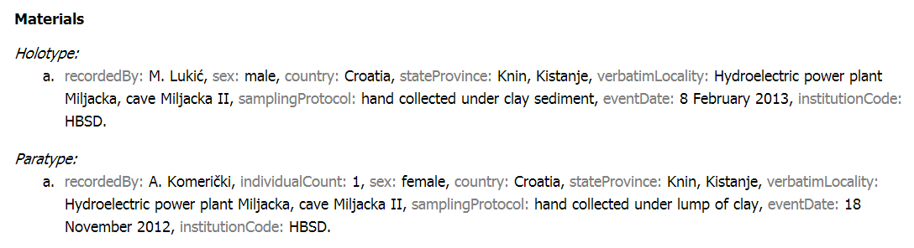
Data converted into text

Slide 30
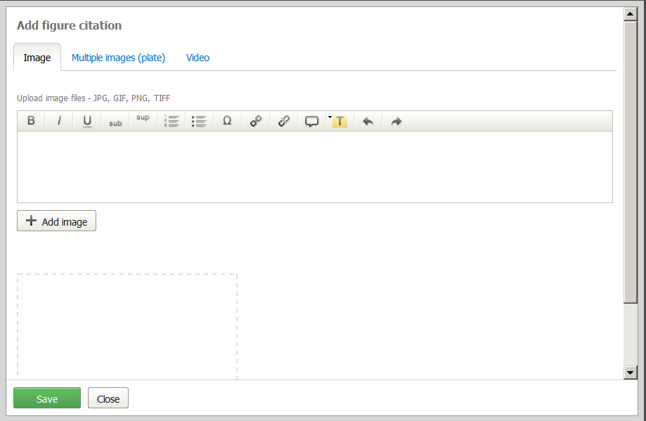
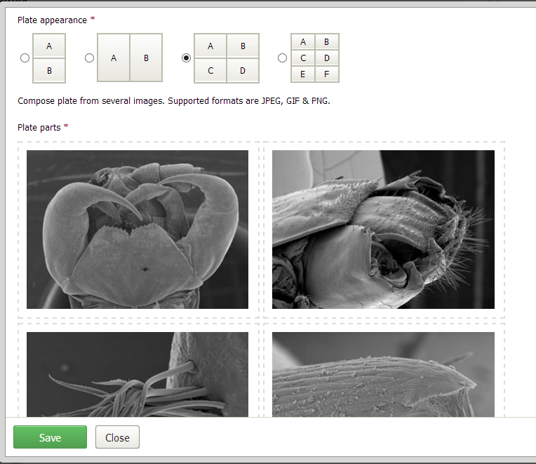
Compose plates

Slide 31
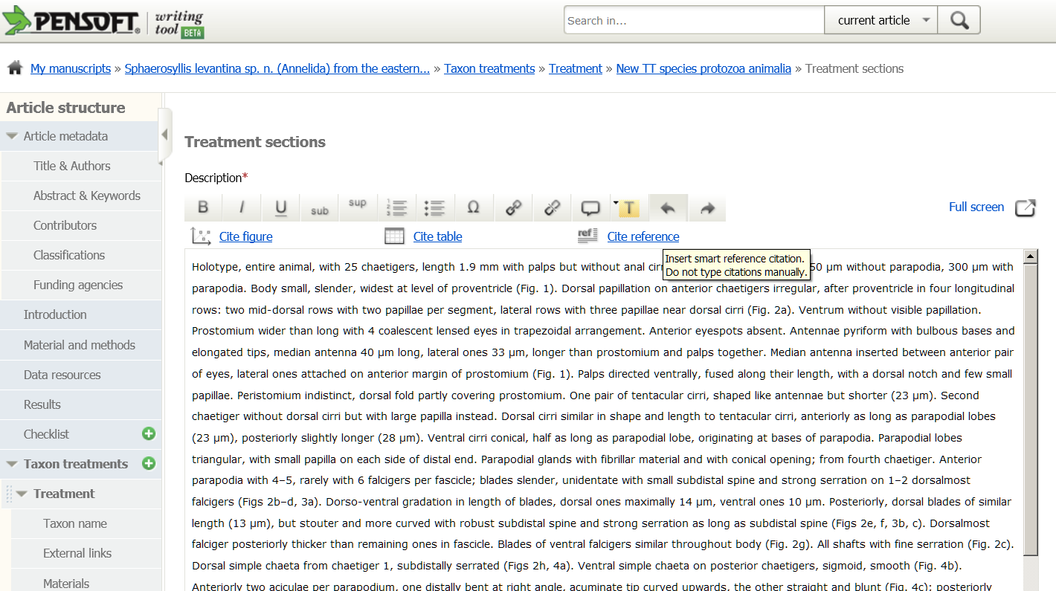

Slide 32
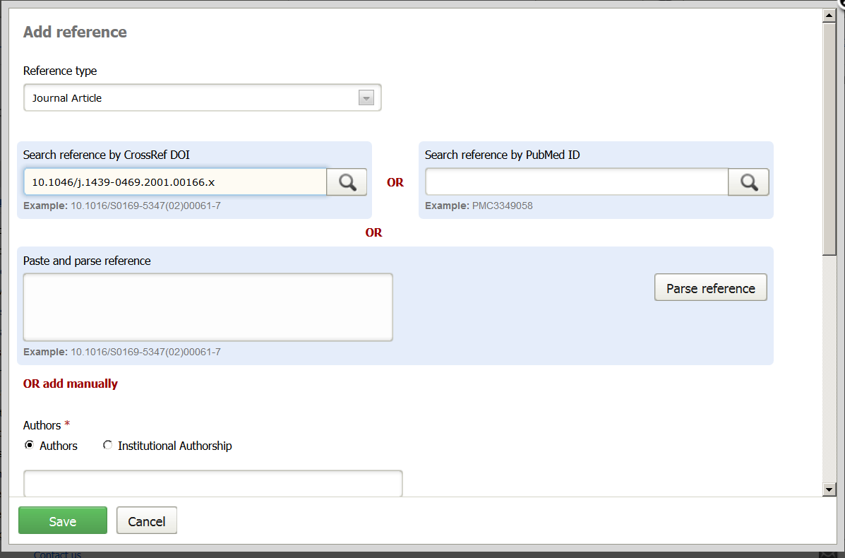
Pick up a reference

Slide 33
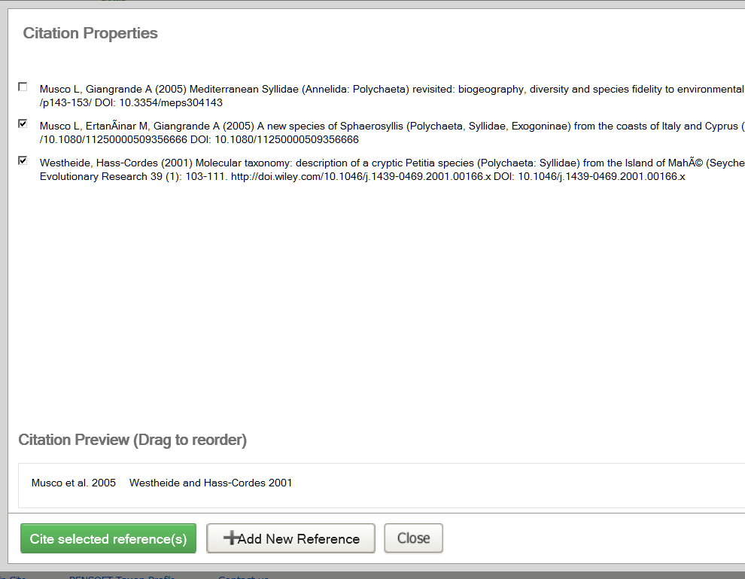
Cite a reference

Slide 34
Novel work flows
Authoring
Peer-review and editorial manager
Publishing and dissemination

Slide 35
Community and public peer-review
Notes:
35
Slide 12: Next generation article publishing
Arguably our most ambitious developments in the context of scholarly communication concern the semi-automated construction of scholarly papers from databases. In many cases Scratchpads contain extensive data relating to the biology and description of particular species. These are highly suited to formal specialist publications, but doing so require the laborious assembly of these data into a manuscript. As part of the ViBRANT collaboration with Pensoft, and in particular their two journals specialising in the formal taxonomic descriptions of plants and animals, we have developed a 5-step workflow for users to selecting appropriate data from their Scratchpad, adding additional metadata describing this information so that it conforms with the norms of descriptive taxonomic publications, and then finally preview and submit this manuscript to the publisher. From here is goes through a standard peer review process. Review recommendations are then incorporated in to a revised version of the manuscript, which is then sent back to the publisher and simultaneously published on both the Scratchpad and in the publisher’s journal.
In addition to dramatically speeding up the construction of scientific papers, the user has the advantage that firstly the manuscript can be revised and updated and new information comes to light on the Scratchpad, while preserving the original version of the manuscript as part of the scholarly record. In addition the publish extracts relevant information from the submitted database which is them automatically submitted to the specialist data repositories.
So in sum then, these are the four ways in which ViBRANT is facilitation scholarly communication of biodiversity information. 1) Through low cost journal infrastructure; 2) by community web publishing; 3) by biodiversity observation data publishing; and 4) by next generation publishing services producing scholarly articles from databases.

Slide 36
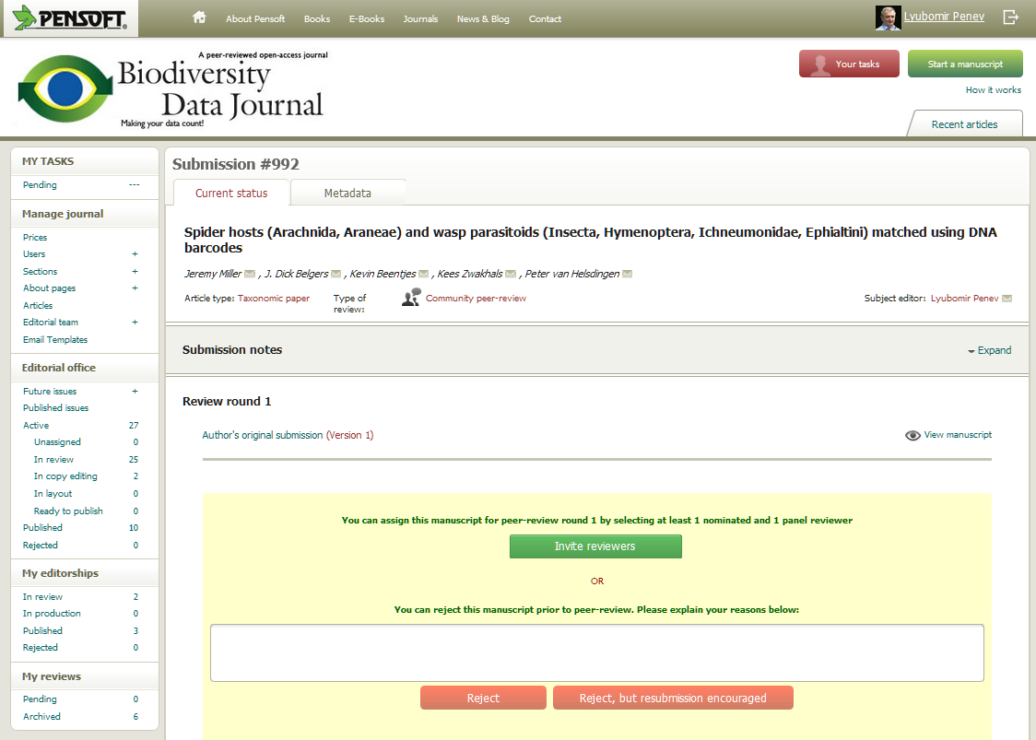

Slide 37
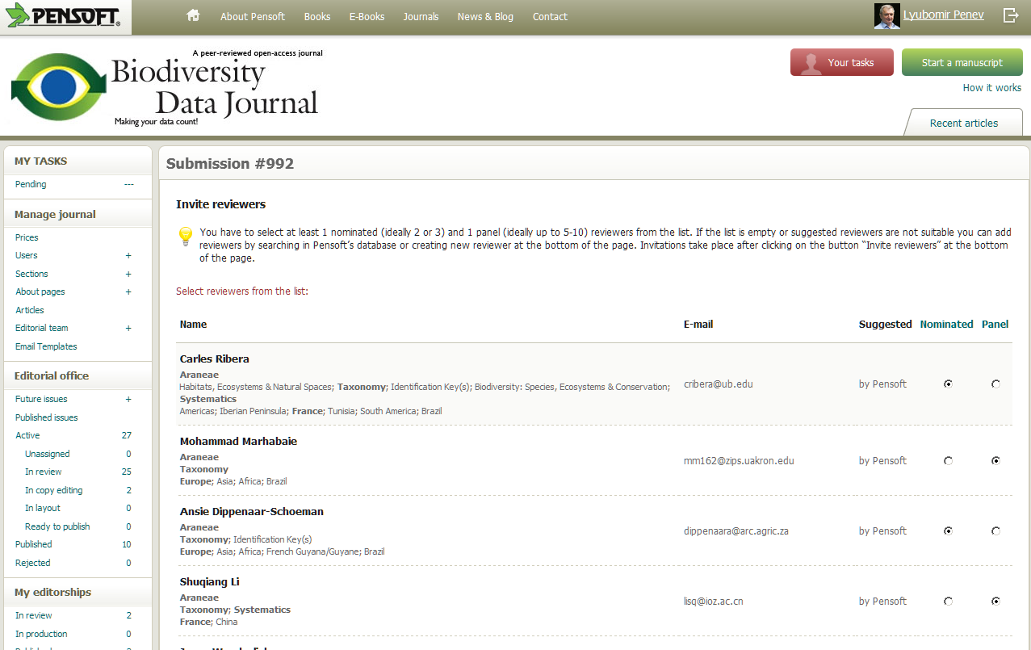

Slide 38
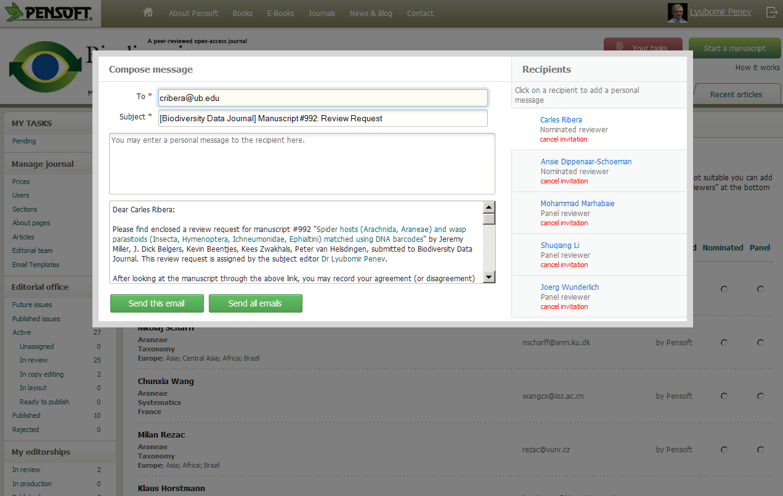
Now imagine…

Slide 39
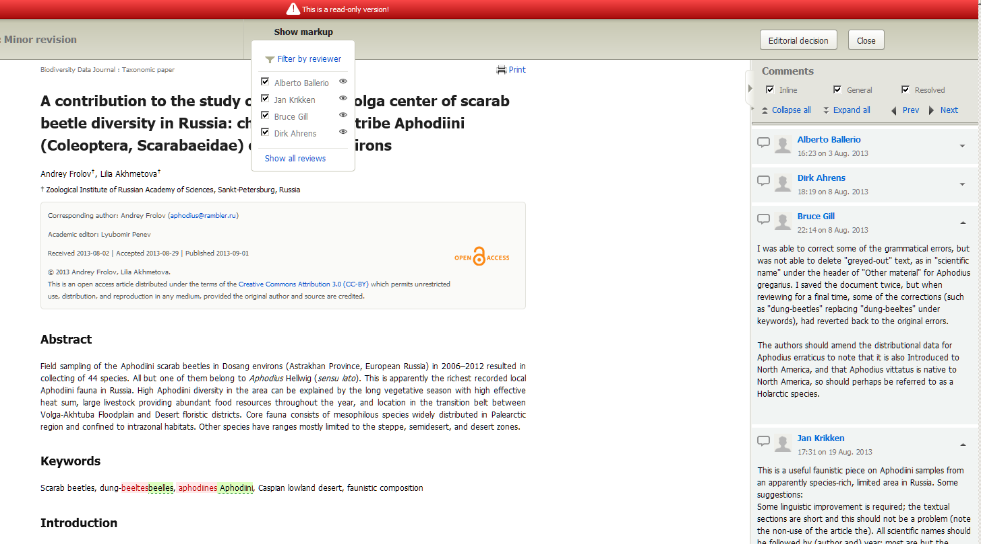
Consolidated Review Version

Slide 40
Novel work flow
Authoring
Peer-review and editorial manager
Publishing and dissemination

Slide 41
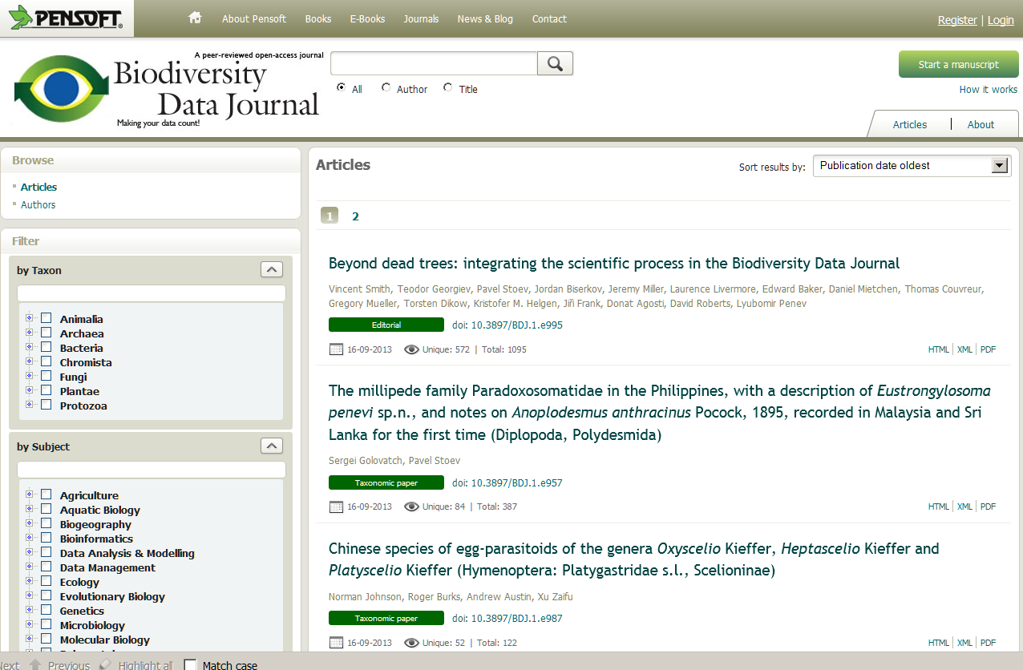

Slide 42
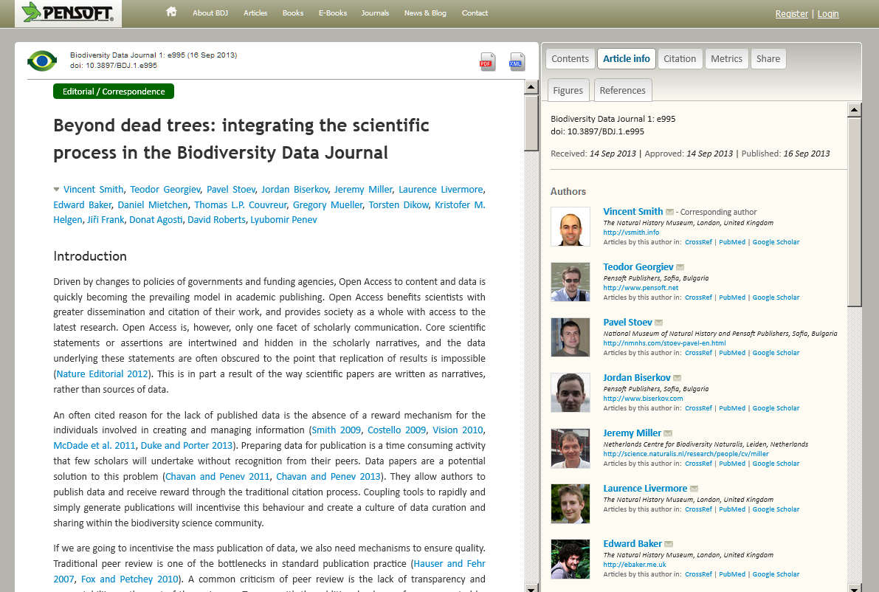
Article metadata

Slide 43
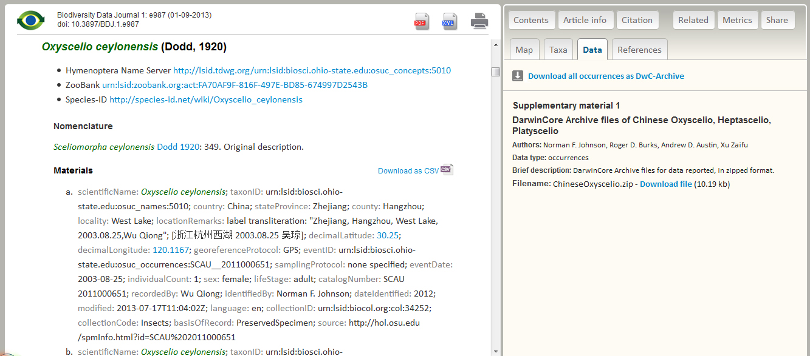
Download data

Slide 44
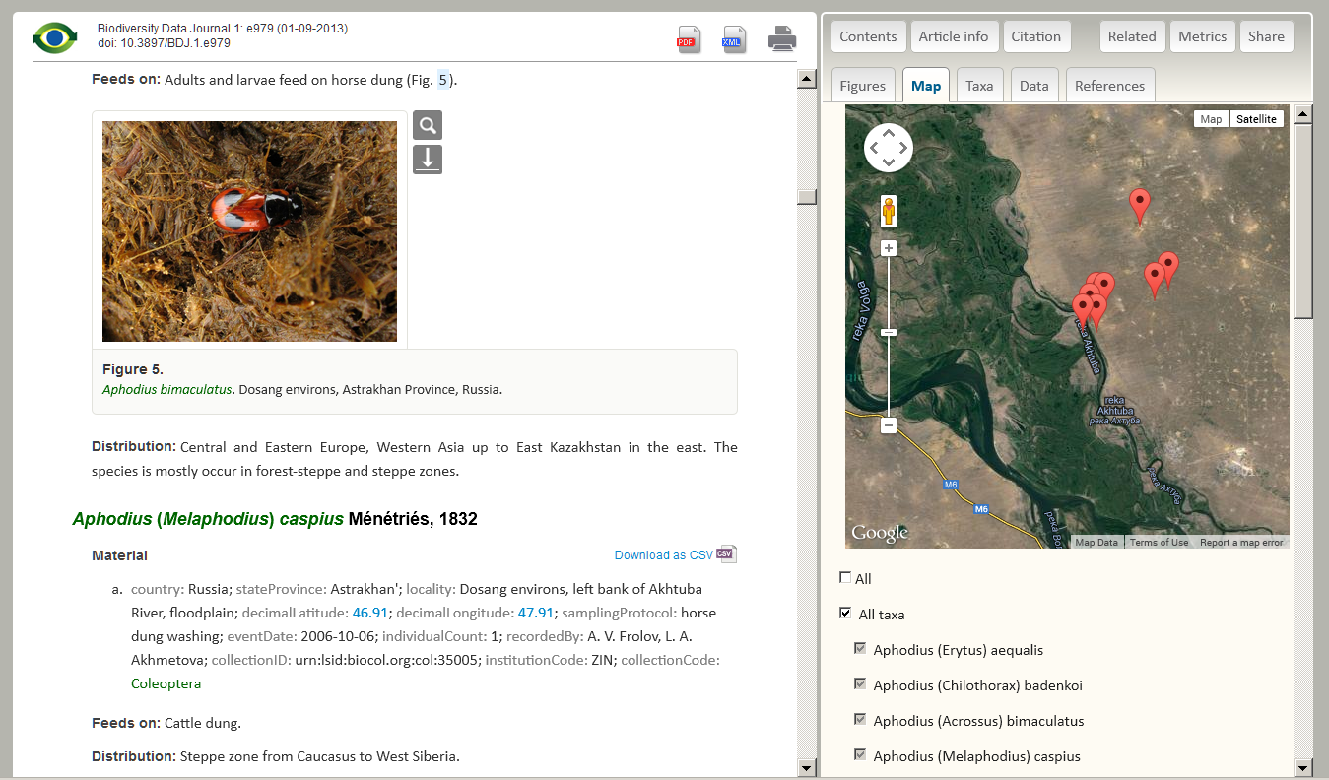
Map distributions

Slide 45
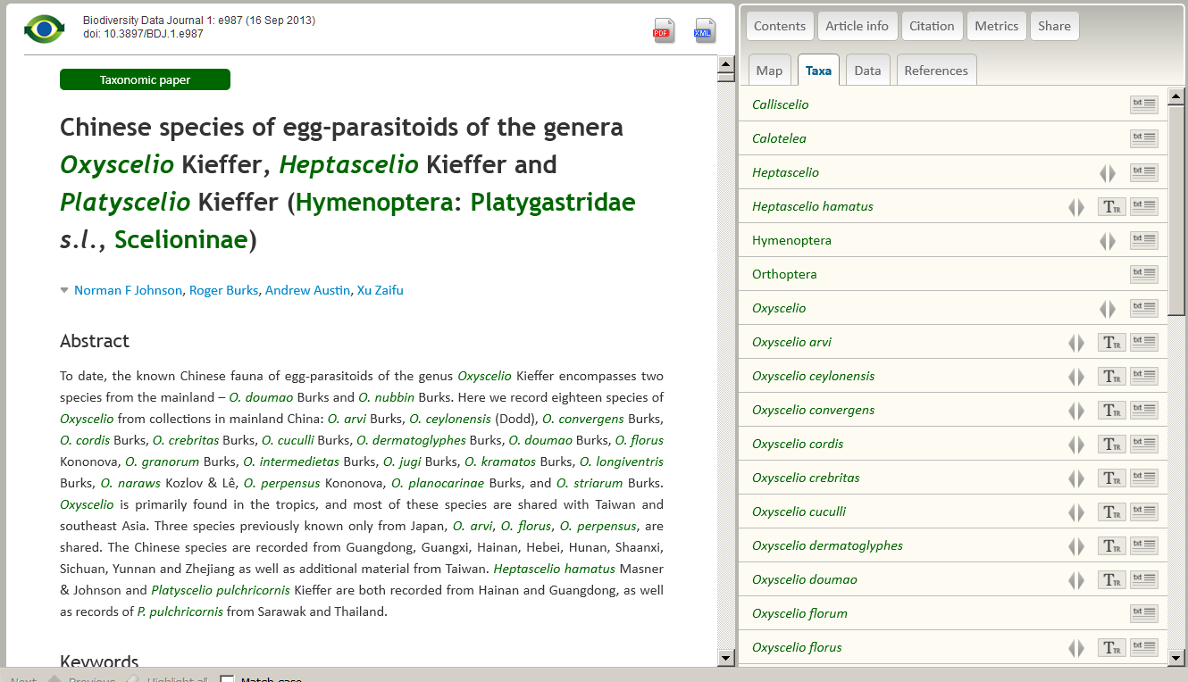
Taxon names and their usages

Slide 46
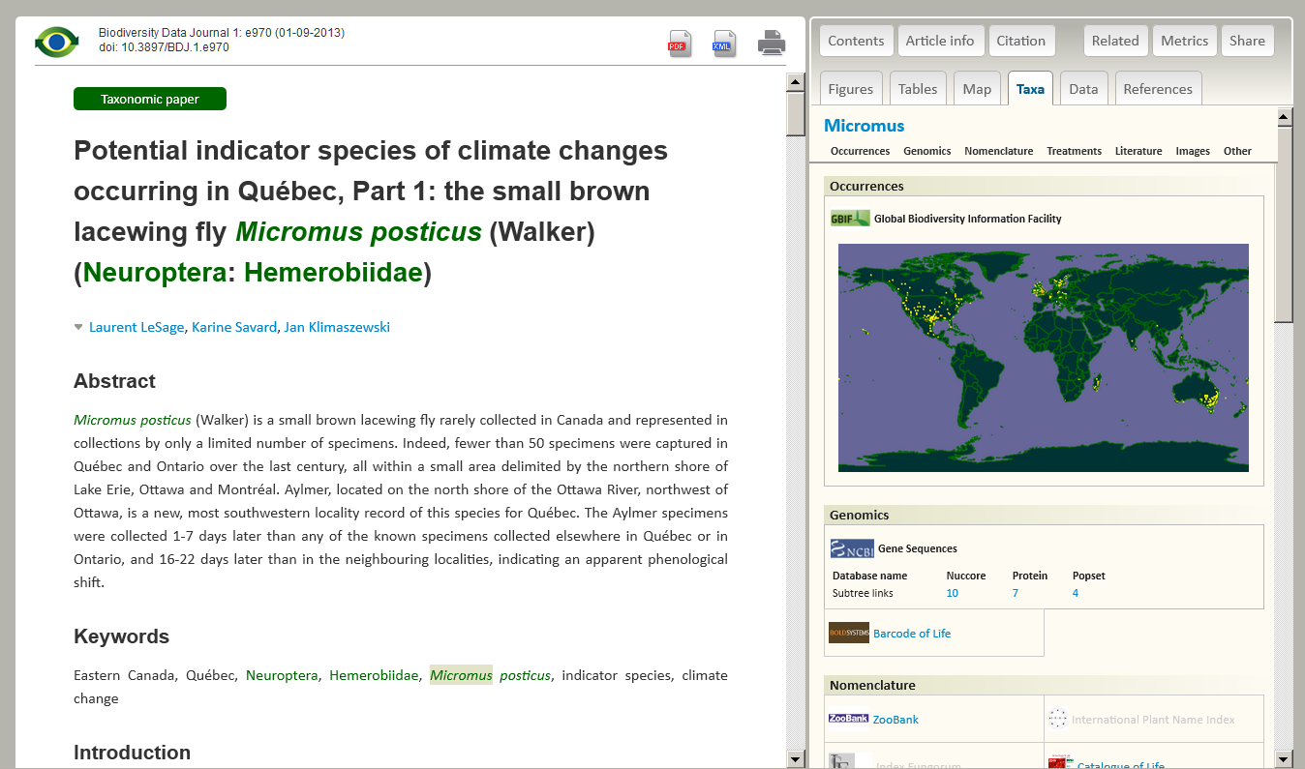
Taxon profile

Slide 47
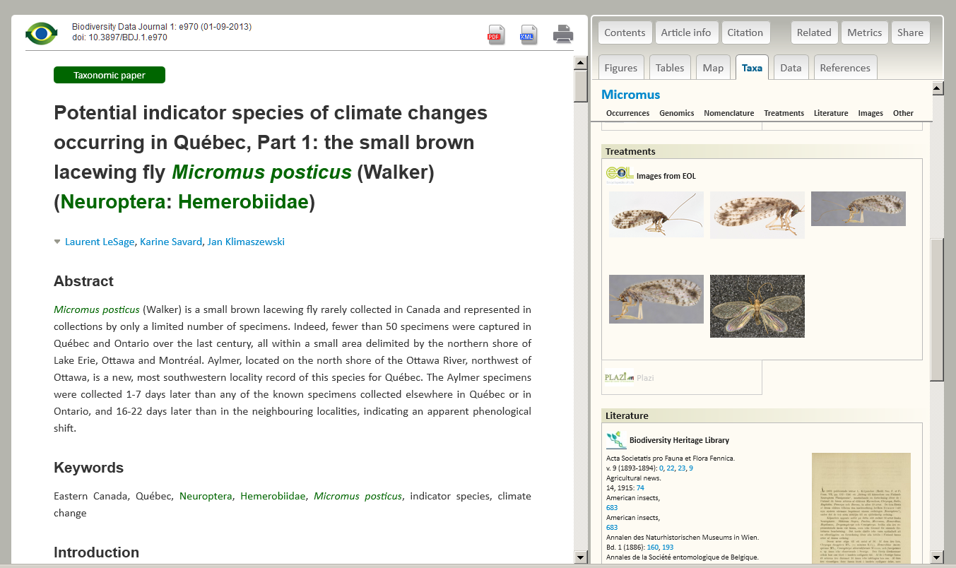
Taxon profile

Slide 48
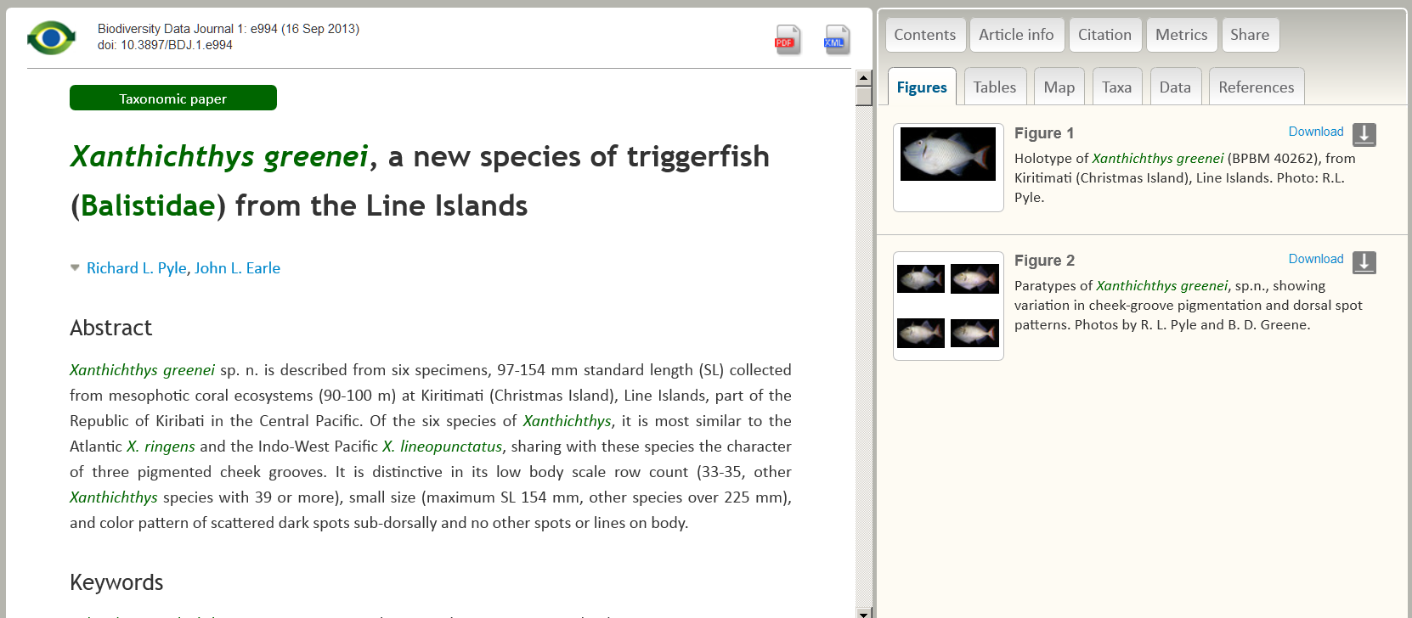
Tables and Figures

Slide 49
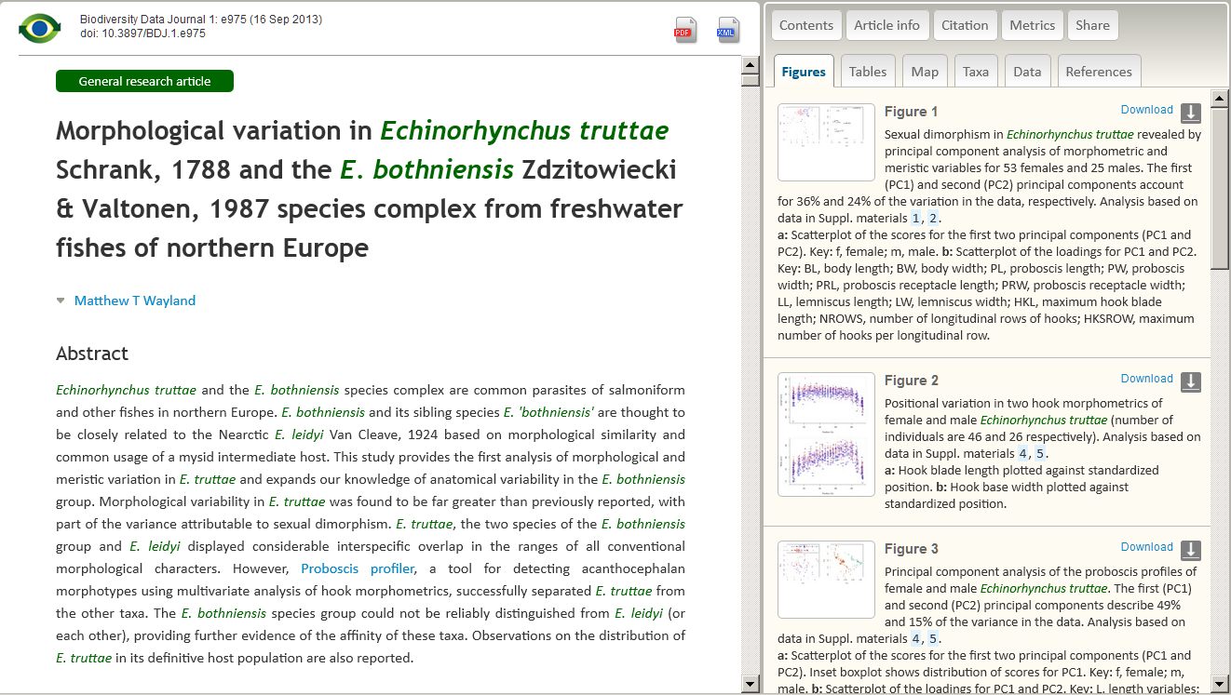
Tables and Figures

Slide 50
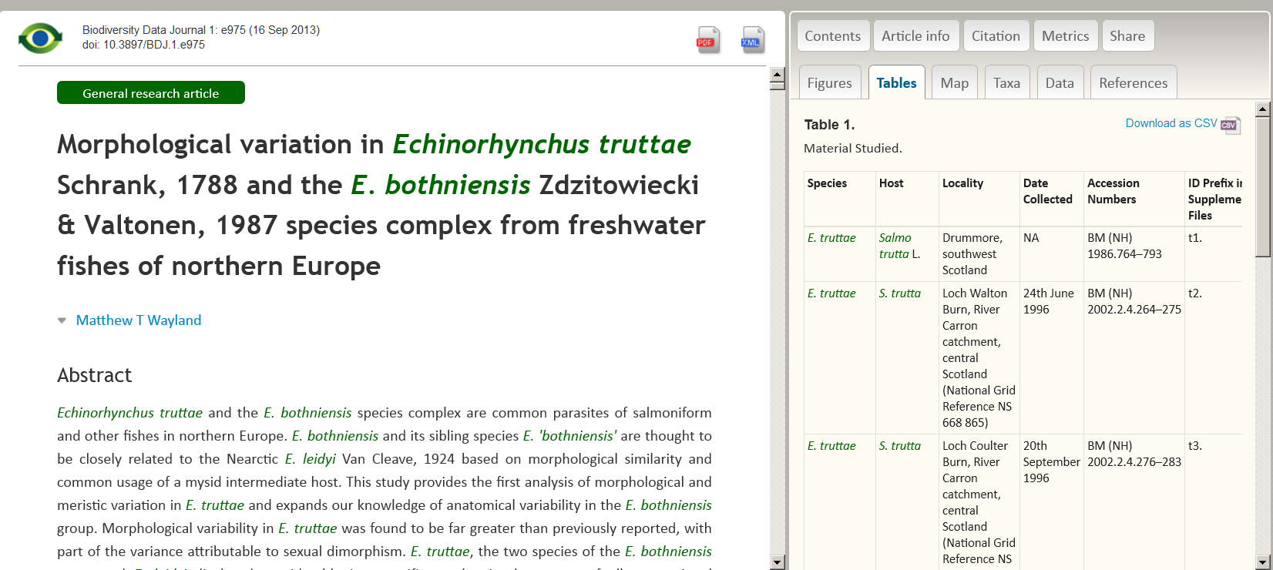
Tables and Figures

Slide 51
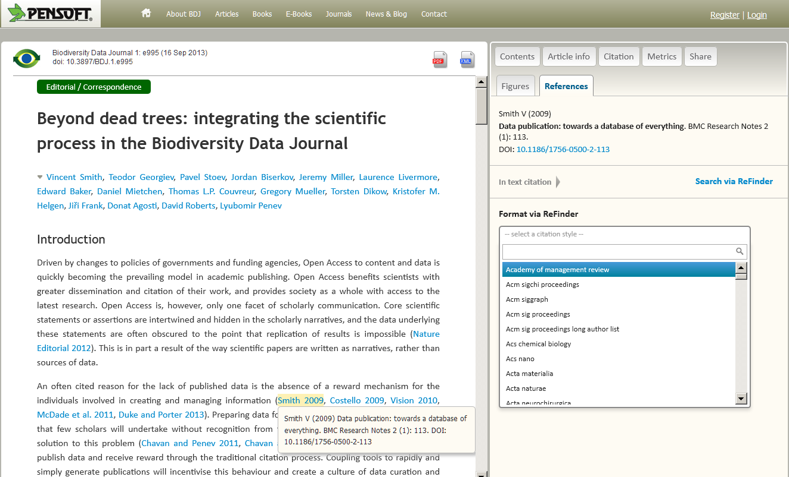
References

Slide 52
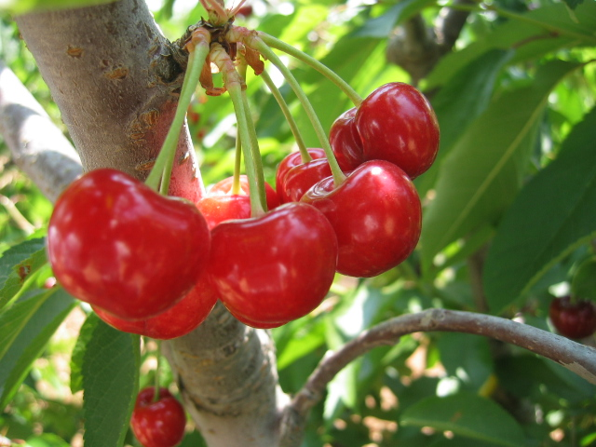

Slide 53
No author guidelines! The tool will guide you!

Slide 54
Authors do not need to markup or hyperlink anything!
PWT does this for you!

Slide 55
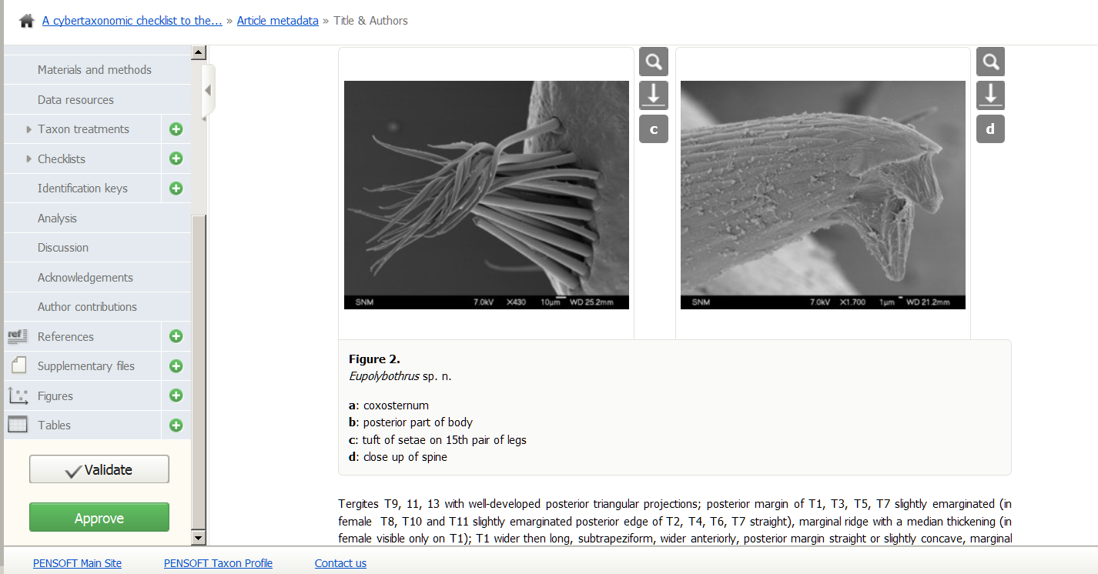
Embedded copyeditor?

Slide 56


Slide 57

Layout stage skipped!

Slide 58

LOW COST!

Slide 59


Slide 60
Why a new journal?
BDJ is not just a new journal
Neither it is a conventional data journal!
A pilot work flow and infrastructure to mobilize, review, publish, store, disseminate, make interoperable,
collate and re-use data
through the act of scholarly publishing!
Notes:
60
Slide 12: Next generation article publishing
Arguably our most ambitious developments in the context of scholarly communication concern the semi-automated construction of scholarly papers from databases. In many cases Scratchpads contain extensive data relating to the biology and description of particular species. These are highly suited to formal specialist publications, but doing so require the laborious assembly of these data into a manuscript. As part of the ViBRANT collaboration with Pensoft, and in particular their two journals specialising in the formal taxonomic descriptions of plants and animals, we have developed a 5-step workflow for users to selecting appropriate data from their Scratchpad, adding additional metadata describing this information so that it conforms with the norms of descriptive taxonomic publications, and then finally preview and submit this manuscript to the publisher. From here is goes through a standard peer review process. Review recommendations are then incorporated in to a revised version of the manuscript, which is then sent back to the publisher and simultaneously published on both the Scratchpad and in the publisher’s journal.
In addition to dramatically speeding up the construction of scientific papers, the user has the advantage that firstly the manuscript can be revised and updated and new information comes to light on the Scratchpad, while preserving the original version of the manuscript as part of the scholarly record. In addition the publish extracts relevant information from the submitted database which is them automatically submitted to the specialist data repositories.
So in sum then, these are the four ways in which ViBRANT is facilitation scholarly communication of biodiversity information. 1) Through low cost journal infrastructure; 2) by community web publishing; 3) by biodiversity observation data publishing; and 4) by next generation publishing services producing scholarly articles from databases.

Slide 61


Slide 62
Imagine how data
(if published in this way) can be re-used…
… across different domains….
Notes:
62
Slide 12: Next generation article publishing
Arguably our most ambitious developments in the context of scholarly communication concern the semi-automated construction of scholarly papers from databases. In many cases Scratchpads contain extensive data relating to the biology and description of particular species. These are highly suited to formal specialist publications, but doing so require the laborious assembly of these data into a manuscript. As part of the ViBRANT collaboration with Pensoft, and in particular their two journals specialising in the formal taxonomic descriptions of plants and animals, we have developed a 5-step workflow for users to selecting appropriate data from their Scratchpad, adding additional metadata describing this information so that it conforms with the norms of descriptive taxonomic publications, and then finally preview and submit this manuscript to the publisher. From here is goes through a standard peer review process. Review recommendations are then incorporated in to a revised version of the manuscript, which is then sent back to the publisher and simultaneously published on both the Scratchpad and in the publisher’s journal.
In addition to dramatically speeding up the construction of scientific papers, the user has the advantage that firstly the manuscript can be revised and updated and new information comes to light on the Scratchpad, while preserving the original version of the manuscript as part of the scholarly record. In addition the publish extracts relevant information from the submitted database which is them automatically submitted to the specialist data repositories.
So in sum then, these are the four ways in which ViBRANT is facilitation scholarly communication of biodiversity information. 1) Through low cost journal infrastructure; 2) by community web publishing; 3) by biodiversity observation data publishing; and 4) by next generation publishing services producing scholarly articles from databases.

Slide 63

XML on GitHub

Slide 64

I Open Access!
Implementation in other domains
welcome!
penev@pensoft.net
PLAZI

Slide 65


Drawings: slavenapeneva.com

